Slide 1
Population Distribution in SE Asia

Slide 2
SS7G11
SS7G11:
“The student will explain the impact of location, climate, physical characteristics, distribution of natural resources, and population distribution on Southern and Eastern Asia.”

Slide 3
SS7G11a
SS7G11a:
“Describe the impact climate and in Southern and Eastern Asia.”
location has on population distribution

Slide 4
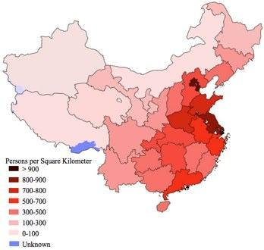
SS7G11a
China and India have the two highest populations in the world
India will pass China within the next few years

Slide 5
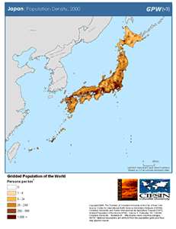
SS7G11a
Many nations in S+E Asia are in the Top Ten for most populous countries:
Indonesia (4th)
Pakistan (6th)
Bangladesh (8th)
Japan (10th)

Slide 6
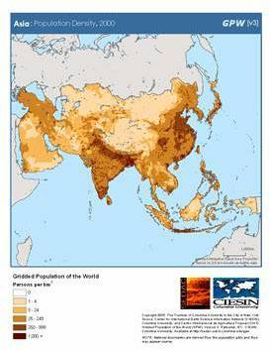
SS7G11a
Populations in S+E Asia are not evenly distributed across the region

Slide 7
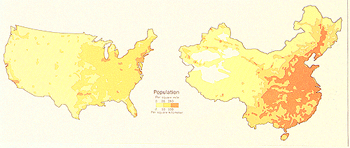
SS7G11a
In SE Asia, where agriculture is important, people live in more suitable conditions
They live near rivers and on river plains to help with farming
They stay away from areas where farming is difficult

Slide 8
SS7G11b
SS7G11b:
“Describe how the mountain, desert, and water features of Southern and Eastern Asia have affected the population in terms of where people live, the types of work they do, and how they travel.”

Slide 9
SS7G11b
Most people in S+E Asia do not live in deserts (Gobi; Taklimakan) or in mountain ranges (Himalayas)
Most people in S+E Asia live near water

Slide 10
SS7G11b
Most major cities in S+E Asia are located near water:
On the banks of navigable rivers
OR… near the coast
OR… BOTH

