Slide 1
South East Asia
By: Heartley Twiggs
By PresenterMedia.com

Slide 2
Main Religions in Southeast Asia
Religion | Country Of Origin | Founder | Sacred Text | Basic Beliefs | Where Found Today
Buddhism | India | Buddha (Siddhartha Gautama) | The Tripitaka | 4 Noble Truths Middle Way Nirvana | South East Asia
Hinduism | Northern India | No Specific Founder | Vedas | Cows are sacred Karma Monotheistic-But many forms of Brahman Reincarnation Caste System | Mostly India
Shintoism (ethnic) | Japan | No specific founder | No sacred text | Kami Worship (Spirits of nature) Nature is sacred Believe non-living things have spirits—like water or rocks | China & Japan
Confucianism (Philosophy) | China | Confucius | Four Books Five Classics | Treat others like you want to be treated | China
Islam | SW Asia | Muhammad | Koran (Quran) | 5 Pillars Pray 5x a day Travel to mecca Charity Fasting Profession of faith | Worldwide
Standard SS7G12- B

Slide 3



Ganges- causes of pollution
Many chemicals that farmers use will wash into the river. People and animals waste are also dumped into the water because sewage from the cities is not treated properly.
SS7G10- A

Slide 4
Health effects
Several diseases have been spread due to the pollution.
SS7G10- A

Slide 5
Yangtze Pollution-causes
Nitrogen & phosphates from fertilizers increase the production of algae
Phosphates contaminate the fish that people then eat
Industrial waste is dumped into rivers
SS7G10- A

Slide 6

Effects
The Algae uses oxygen that fish need. This leads to the death of the fish.
People are getting sick from eating the fish.
There is an increase in the number of birth defects and cancer.
SS7G10- A

Slide 7
Describe the two predominant forms of democratic governments: parliamentary and presidential.
The main difference between a parliamentary and presidential system of government is that in a presidential system, the president is separate from the legislative body, but in a parliamentary system, the chief executive, such as a prime minister, is part of the legislative body, or parliament. A presidential system separates the executive and legislative functions of the government and provides what are commonly called checks and balances to limit the power of both the chief executive and the legislature. In a parliamentary system, the legislature holds the power, and the chief executive must answer to the legislature. Another main difference is that in a presidential system, the chief executive and members of the legislature are elected separately by the people, but in a parliamentary system, the legislature is elected by the people and then must appoint or recommend for appointment one of its members to be the chief executive.
Standard SS7CG6- C:

Slide 8

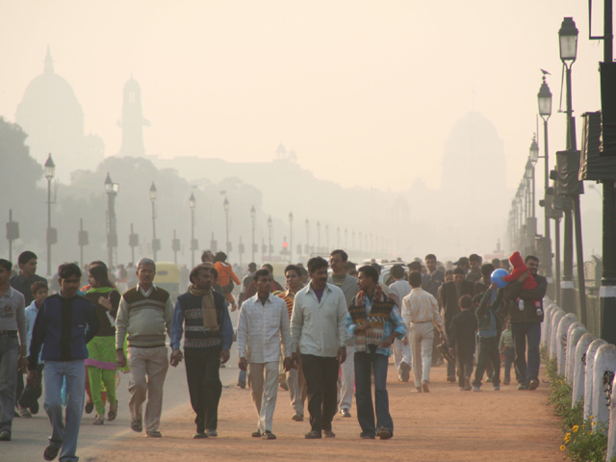
India air pollution
Respiratory disease is the result of air pollution from factories and cars
Standard SS7G10- B

Slide 9
According to the World Health Organization, the capital city of New Delhi is one of the top ten most polluted cities in the world.
Surveys indicate that in New Delhi the incidence of respiratory diseases due to air pollution is about 12 times the national average.
Standard SS7G10- B

Slide 10
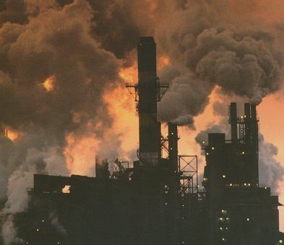
Standard SS7G10- B

Slide 11
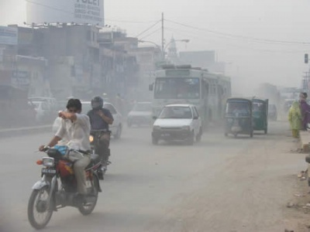
More than one million cars are being added to India’s roads every year — a growth rate averaging 10.2 percent annually over the last five years.
Standard SS7G10- B

Slide 12
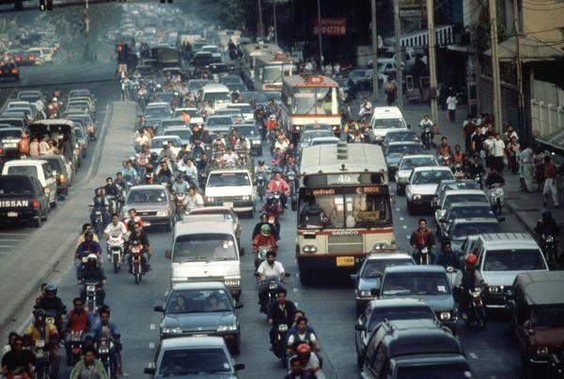
Poor people are afraid that laws limiting industry may cause them to lose jobs
Standard SS7G10- B

Slide 13

Haze from pollution known as “brown clouds” may cause changes in climate such as reduction of rainfall & temperature.
Standard SS7G10- B

Slide 14
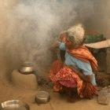
Air pollution in the country
Rural areas also have air pollution from using coal and wood fires in their homes
Inhaling the smoke from these fires is like smoking 20 packs of cigarettes a day!
Standard SS7G10- B

Slide 15
Air Pollution in China
Athletes in the Beijing Olympics in 2008 were concerned about air quality
Coal is the main source of fuel in China
A leading cause of death in China is respiratory and heart disease
The Beijing Municipal Protection Agency was formed to help lower air pollution
Health problems have caused a reduction in China’s economic growth
Standard SS7G10- B

Slide 16
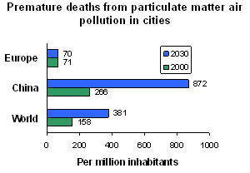
Compared to the rest of the world China has far greater % of people getting sick from air pollution
Standard SS7G10- B

Slide 17
From a news article 2007
Beijing has already introduced a raft of anti-smog measures to clear the air, including halving the number of cars on the road each day and shutting down thousands of factories in and around the city.
It has also formed a crisis plan to remove 90 per cent of cars from the streets and shut down even more industry if the pollution remains high as the Games approach.
Standard SS7G10- B

Slide 18



How does literacy rate affect standard of living?
The literacy rate of a country affects the standard of living by raising it. This is because there are more, better, and more advanced jobs open to a individual or population that has a higher literacy rate, especially high-paying jobs.
Standard: SS7G12-C

Slide 19
Agenda or Summary Layout
A second line of text could go here
Item 1
Discussion Item One – A Placeholder for text
Add a second line of text here
Item 2
Discussion Item Two – A Placeholder for text
Add a second line of text here
Item 3
Discussion Item Three – A Placeholder for text
Add a second line of text here
Item 4
Discussion Item Four – A Placeholder for text
Add a second line of text here
Item 5
Discussion Item Five – A Placeholder for text
Add a second line of text here

Slide 20

World Experience!
This picture can be replaced with a picture of your choosing.

Slide 21
Bar Graph Page Layout
Here is the description of the graph. This chart is enhanced with features from PowerPoint 2007 or higher.
Here is some more text. You may delete the graphical elements.

Slide 22

Comparison Page
This is a place holder for item one. Item one can be text, a picture, graph, table, etc. This is a place holder for item one. Item one can be text, a picture, graph, table, etc.
All the graphical elements can be moved, copied, or deleted from the slide master view.
This is a place holder for item two. Item two can be text, a picture, graph, table, etc.
This is a place holder for item two. Item two can be text, a picture, graph, table, etc.

Slide 23
Example Pie Graph
This is a PowerPoint 2007 or higher enhanced graph. You may change this graph as you wish.
This chart utilizes features available in PowerPoint 2007 or higher.

Slide 24

This is a group of people who share a belief system. They believe in the same God(s) and have common sacred text with a specific set of rules about how to live. They can have many things in common. God(s), prophets, sacred text, religious laws, holy laws, etc.
The differences of ethnic groups and religious groups
Ethnic Groups
Religious Groups
Same
Within
Their group they both share common things
This is a group of people who share a common culture. These characteristics have been part of their community for generations. They can have many things in common. Shared history common ancestry language, religion, etc.
Standard: SS7G12- A

Slide 25
Smart Art Page Layout
Topic 4
Topic 3
Topic 2
Topic 1
Global Concerns
This chart utilizes Smart Art which is feature in PowerPoint 2007 or higher. If you wish to make charts like this and don’t have PPT 2007, we have provided the graphical elements to help you build this yourself.

Slide 26
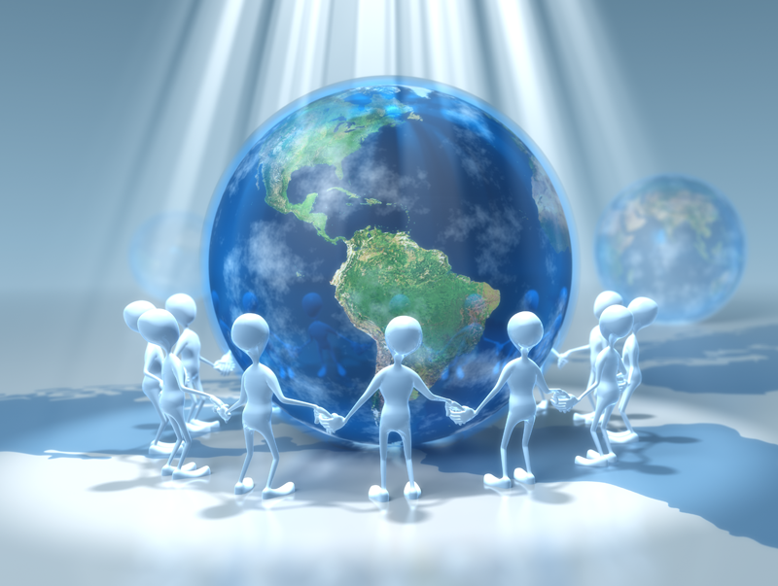
Picture Layout
Picture description

Slide 27

A Two Column Page Layout
QUICK FACT
A content placeholder. Use for text, graphics, tables and graphs. You can change this text or delete it. A content placeholder. Use for text, graphics, tables and graphs. You can change this text or delete it. A content placeholder. Use for text, graphics, tables and graphs. You can change this text or delete it.
A content placeholder. Use for text, graphics, tables and graphs. You can change this text or delete it.
QUICK FACT
A content placeholder. Use for text, graphics, tables and graphs. You can change this text or delete it. A content placeholder. Use for text, graphics, tables and graphs. You can change this text or delete it. A content placeholder. Use for text, graphics, tables and graphs. You can change this text or delete it.
A content placeholder. Use for text, graphics, tables and graphs. You can change this text or delete it.

Slide 28



Three Picture Page Layout
A description of the first picture. You may change this text.
A second place holder is available here. Add as much text as you would like.
A description of the second picture. You may change this text.
A second place holder is available here. Add as much text as you would like.
A description of the third picture. You may change this text.

Slide 29


Two Picture Page Layout
A placeholder for text for the first picture
    More information can be added here by changing this text.
    You can modify this page’s formatting by editing the page layouts under the slide master view.
A placeholder for the second picture
    More information can be added here by changing this text.
    You can modify this page’s formatting by editing the page layouts under the slide master view.

Slide 30


Animation Page
Make an Impact in your presentations by adding some themed PowerPoint animations.

